Slide 1
Digital Signal Processing
Lecture-6
Presented By: Dr. Kiran Khurshid

Slide 2
Determine the response of the system using matrix method
x(n)= {1,2,0.5,1}
↑
h(n)={1,2,1,-1}
↑

Slide 3
Linear and Circular Convolution
x(n)= {1,2,3,4}
h(n)={-3,2,1}

Slide 4
Link of video: https://www.youtube.com/watch?v=KuXjwB4LzSA

Slide 5
DeConvolution
x(n)= {1,1,-1}
y(n)={1,3,1,-2}

Slide 6
Band limited Signal
Antialiasing Filter
Zero Interpolation, Step Interpolation, Linear Interpolation
X(3n/2)

Slide 7
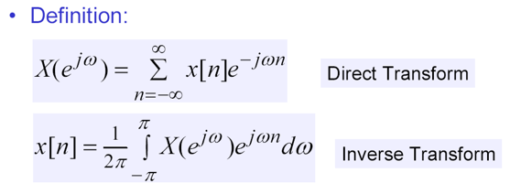
DTFT (Discrete Time Fourier Transform
Mathematically, if x(n) is a discrete-time sequence, then its discrete-time Fourier transform is defined as −

Slide 8
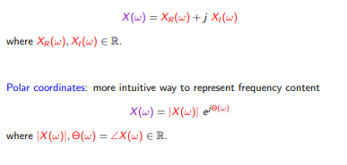
Magnitude and phase

Slide 9
x(n)=1 for n =0 to 4 find DTFT

Slide 10
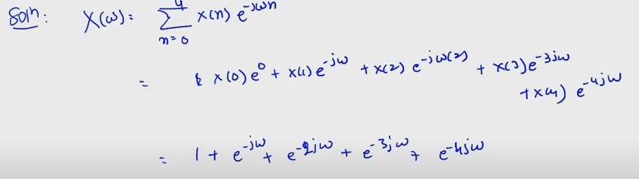

Slide 11

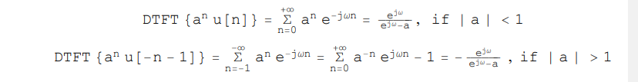
Find DTFT
a) x(n)=0.5^{n}u(n)
b) x(n) = a^{|n|}

Slide 12
